Slide 1
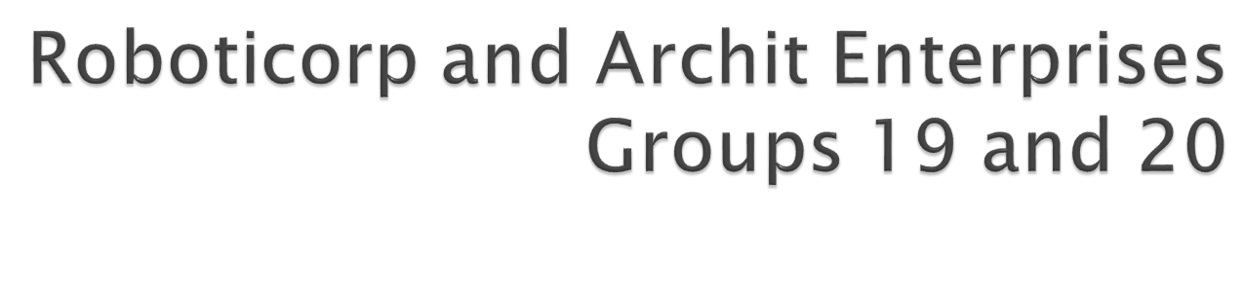
Tang, Raymond McMillion, Andrew Rupakhetee, Archit Lenig, Tyler
Morgan, Laura
Miaw, Jireh
Hauser, Steven
Dworak, Catherine
Bertoglio, David

Slide 2

    Swinging Arm
    Movement with sounds
    WASD continuous-movement controls
    Arc movement
    Text macros
    Connect and disconnect functionality
    Speed-increment and -decrement hotkeys

Slide 3

Good
  Specifying communications protocol before starting
  Consistent meeting times
  Got to work with others to complete a significant project
  Learned to communicate via singular point-of-contact
Bad
  LejOS: API and poor support for other operating systems
  Making schedules work together
  Learning curve with third-party tools
Ugly
  Stolen robot

